Slide 1


Face Mask Detection
MINI PROJECT PHASE-2
Presented by:
Akash S S (1DS18IS008)
Kedar Hegde (1DS18IS035)
Rahul B V (1DS18IS045)
Sandesh S Hegde (1DS18IS057)
Under The Guidance Of
LATHA A P
Assistant Professor
Dept. of Information Science
and Engineering
DSCE, Bangalore

Slide 2
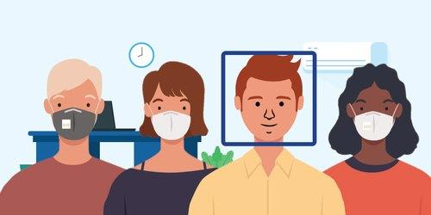
Face Mask Detection

Slide 3

Problem Statement
Detect people that pass through a security-like camera and identify their face mask usage.

Slide 4
Existing System
The dataset has images having masked and unmasked human faces. An existing XML file helps us to detect faces from the image. Imported OpenCV reads an image and it returns an object of NumPy array by default and using img.shape we are checking the height and width of the image and it also returns 3 which is the color channel of the image.
Divide the dataset into ‘test’ and ‘train’. With the use of SVM algorithm, train a model.
The captured image is compared with the trained model which in turn gives the required output.

Slide 5

Proposed System
Face Mask Detection System uses existing IP cameras and CCTV cameras combined with Computer Vision to detect people without masks.
An existing XML file helps us to detect faces from the video.
A continuous video stream in which faces are detected using an XML classifier is compared with the trained model to verify whether the person is masked or not.

Slide 6

Hardware & Software Requirements
HARDWARE REQUIREMENTS
Desktop or Laptop with Windows/Linux/macOS having specs:
4 GB RAM (or higher).
Minimum of 2 GB of memory (HDD or SSD).
High-speed Internet Connection.
Integrated or a separate Webcam.
Graphics Card 512 MB (or higher).
Facemasks for testing.
SOFTWARE REQUIREMENTS
Python IDE (Spyder or PyCharm).
pip installer to install modules.
Modules like TensorFlow, Keras, NumPy, CV2, etc.
Haar Cascade Classifier

Slide 7
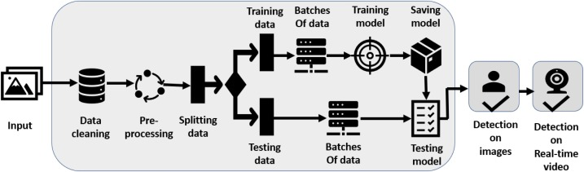
Architecture Diagram

Slide 8
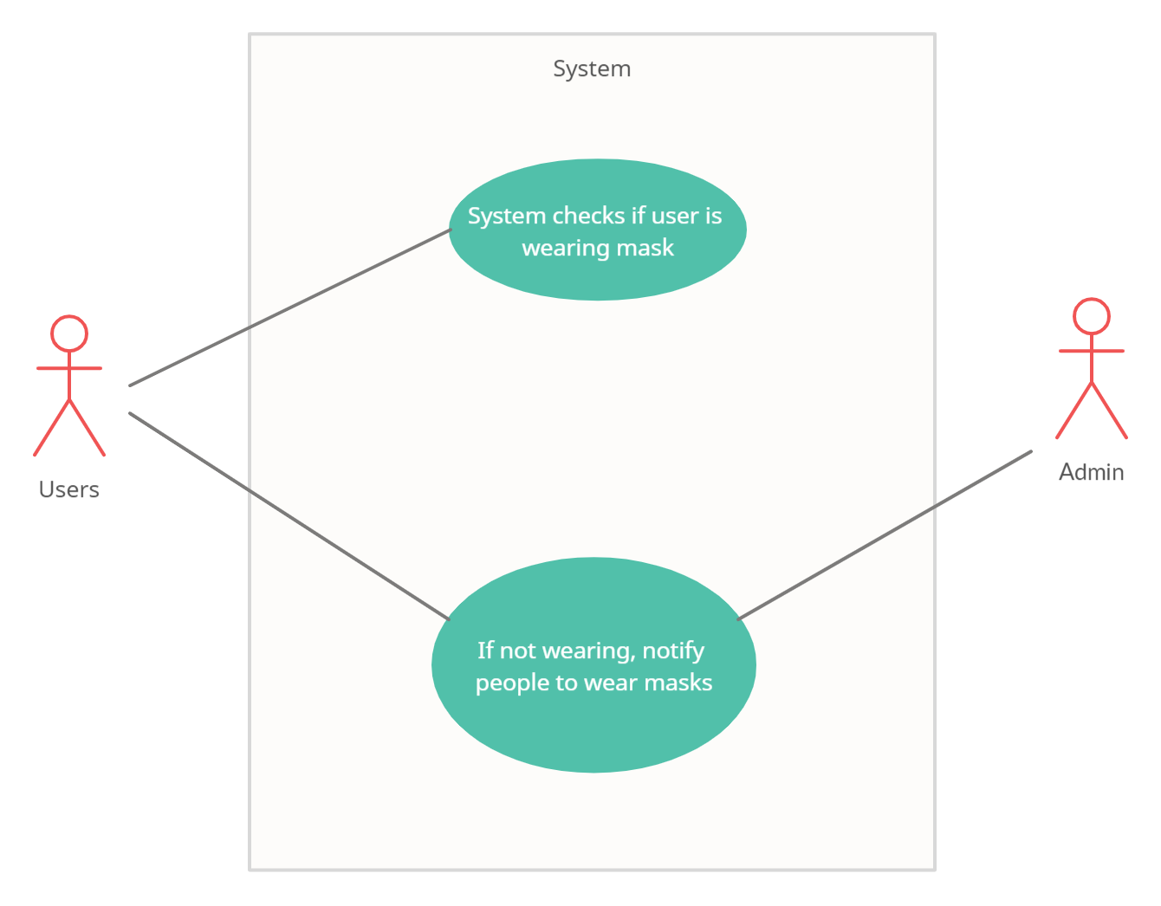
USE Case Diagram

Slide 9
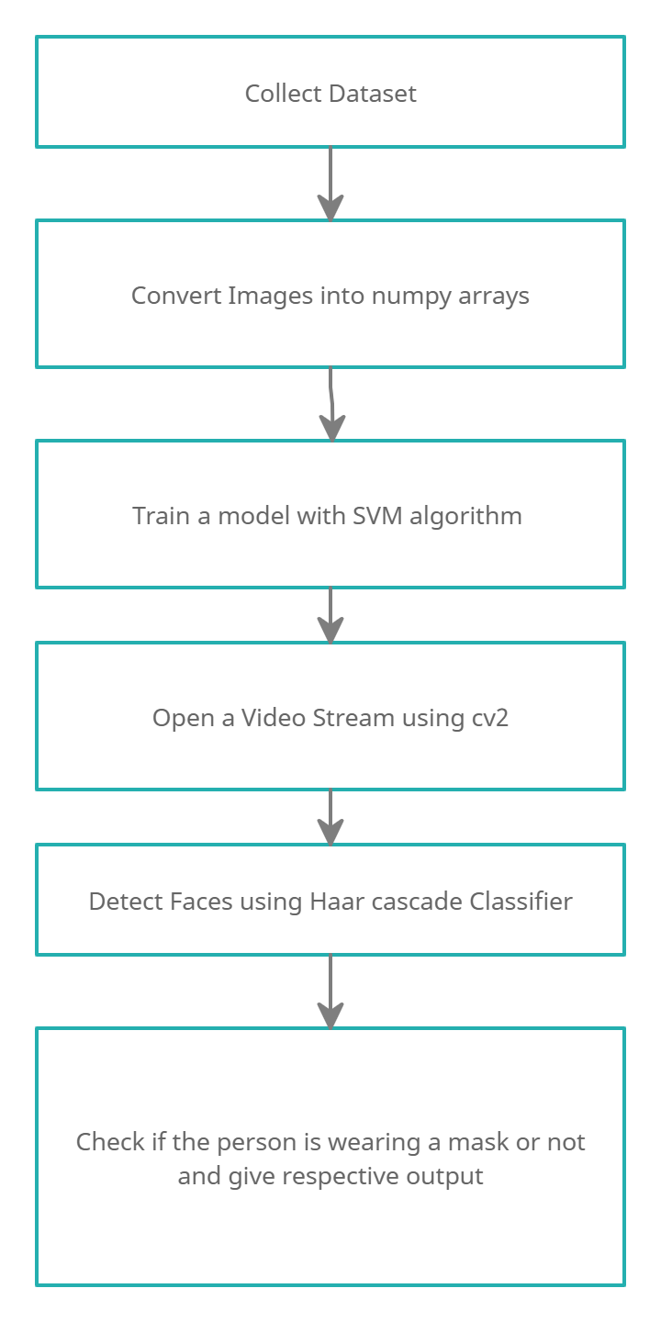
Sequence Diagram

Slide 10
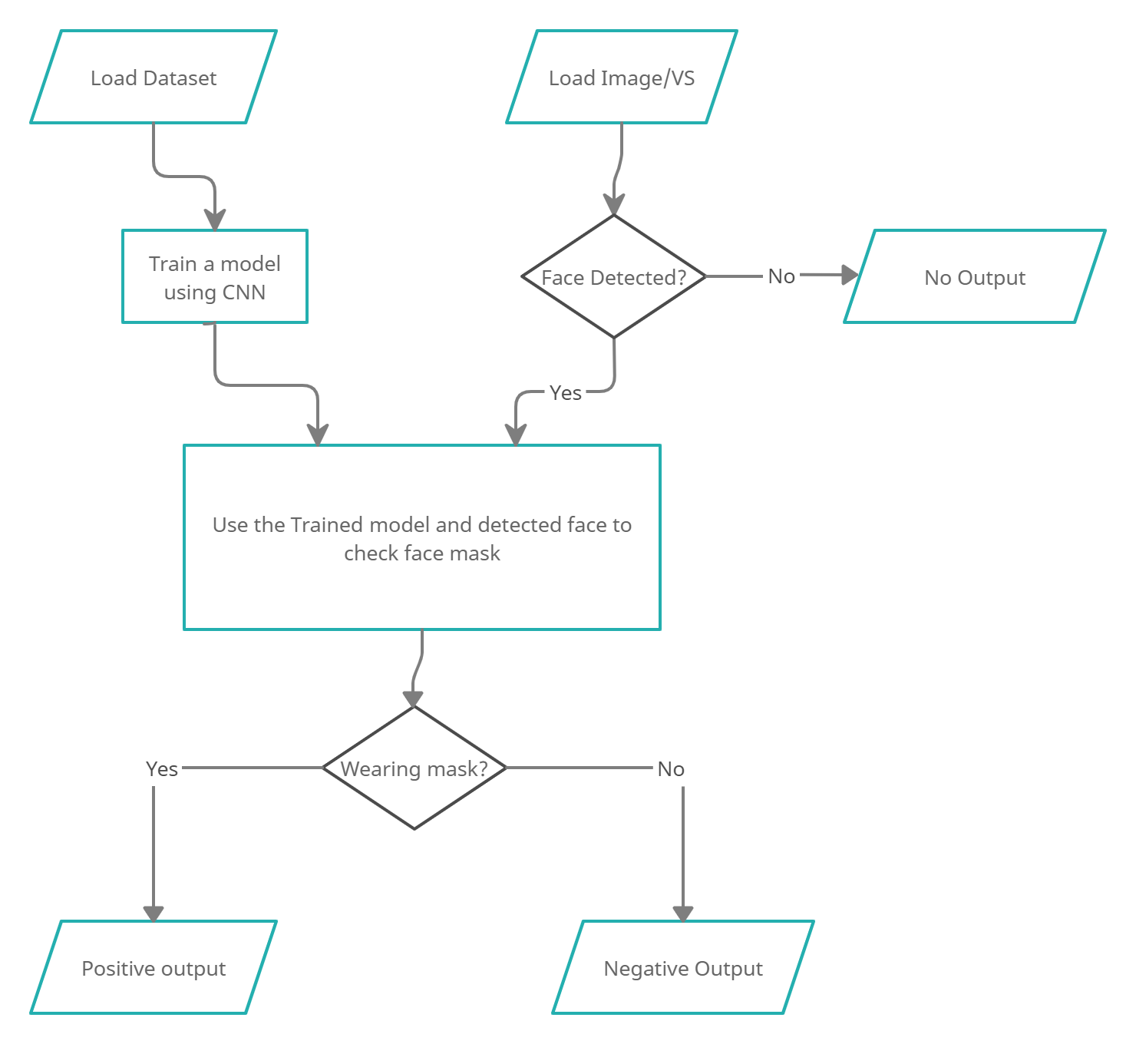
Flowchart

Slide 11
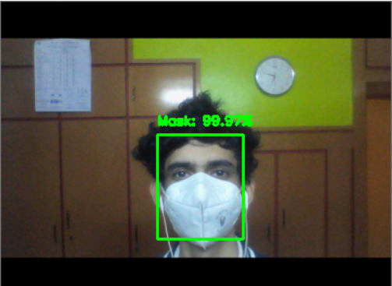
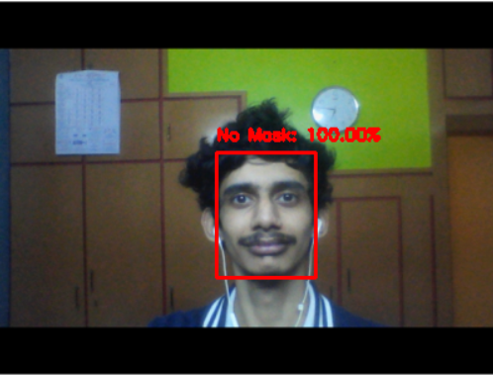
Implementation
Without Mask
With Mask

Slide 12

Objectives achieved as per time frame
Collect Dataset.
Convert images into NumPy arrays.
Detect faces using Haar Cascade Classifier.
Check if the person in the image is wearing a mask or not and give the respective output.

